Slide 1
Custom DocuSign for Salesforce Integration Setup

Slide 2
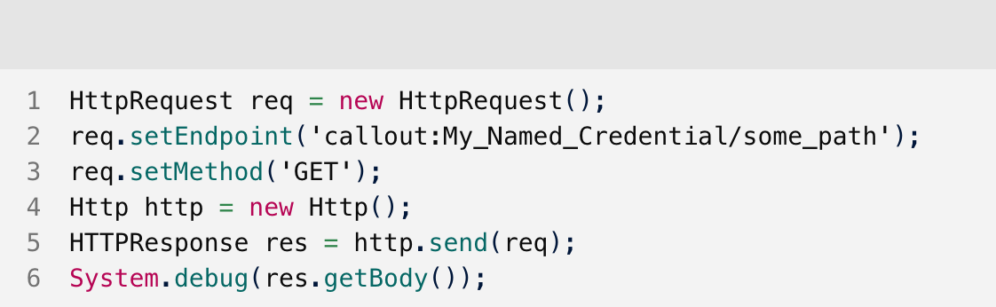
Custom DocuSign for Salesforce Integration
Named Credentials lets Salesforce manage all authentication for Apex callouts so all you need are the API endpoints

Slide 3
Steps
Create DocuSign Integration Key
Create RSA Keypair and use command line to modify private key to Salesforce format to upload into Salesforce Certificate and Key Management
Create Auth. Provider and go through DocuSign OAuth consent process
Create External Credentials
Create Named Credentials
Test API call from Salesforce Developer Console

Slide 4
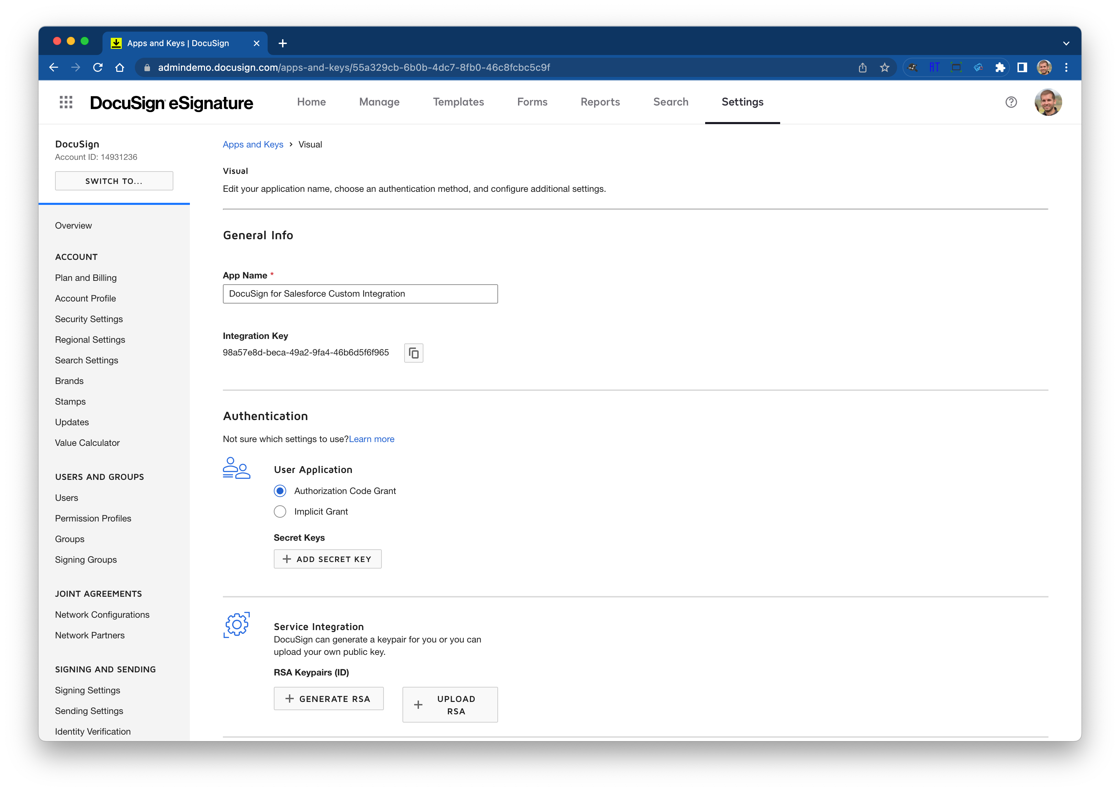
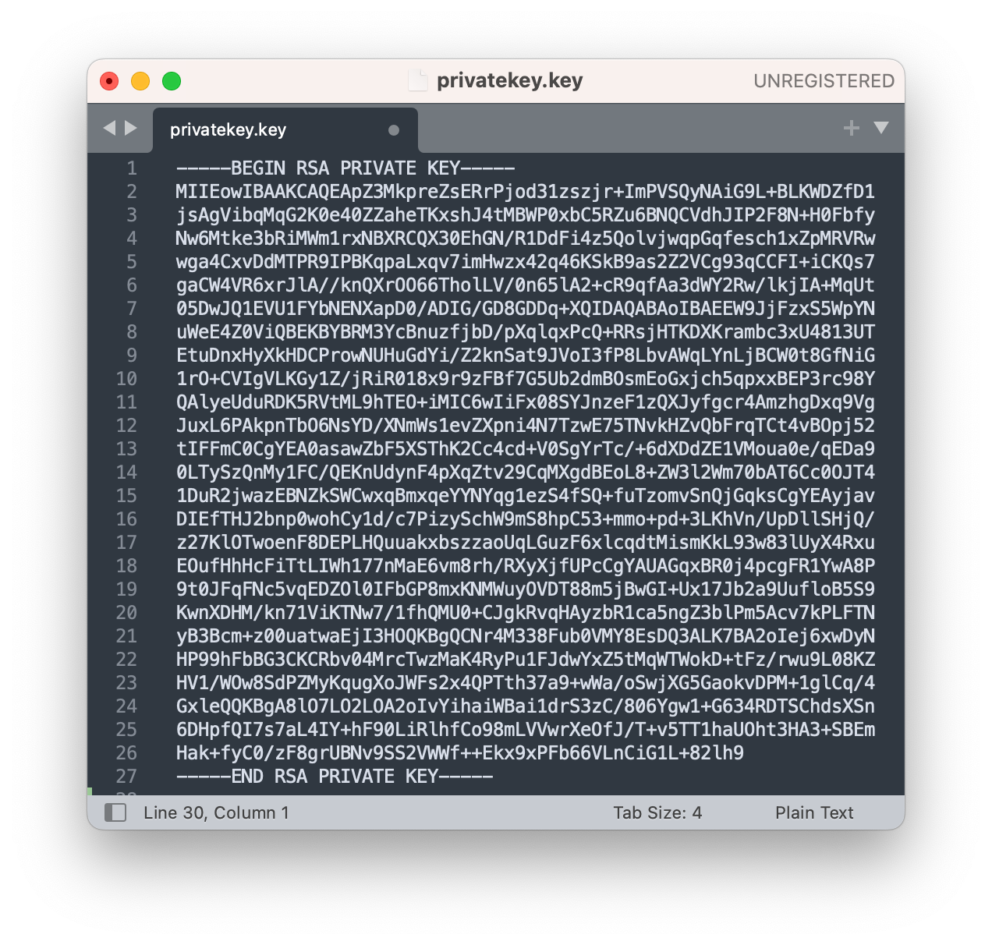
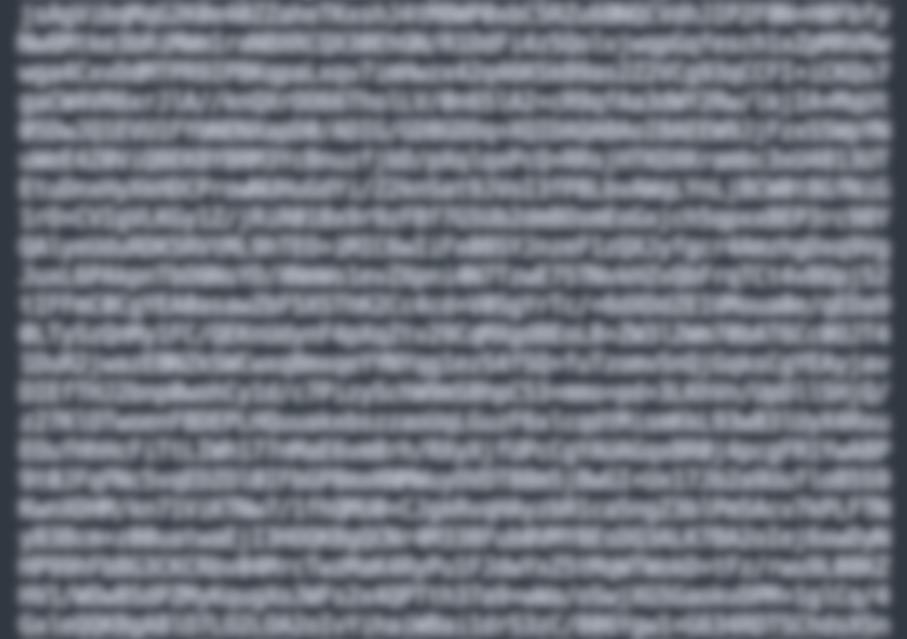
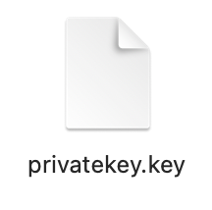
Create DocuSign Private Key
Go to your DocuSign admin settings
Create an App or Key if you haven’t already
Click Generate RSA to create a DocuSign public and private key for
Save the private key including ALL text as a file with the extension of .key
Notes:
https://docs.servicenow.com/bundle/sandiego-application-development/page/administer/integrationhub-store-spokes/task/set-up-docusign.html#generate-jks-certificate
https://www.apexhours.com/salesforce-oauth-2-0-jwt-bearer-flow/

Slide 5
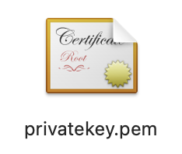
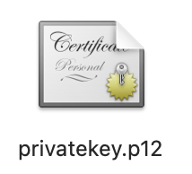
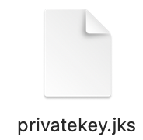
Create Salesforce Signing Certificate
Create .pem from Private Key
openssl req -new -x509 -key <file-name>.key -out <certificate-name>.pem -days 1095 openssl req -new -x509 -key privatekey.key -out privatekey.pem -days 1095
Create .p12 from .pem and .key
openssl pkcs12 -export -in <certificate-name>.pem -inkey <file-name>.key -certfile <certificate-name>.pem -out <PKCS-12-file-name>.p12 openssl pkcs12 -export -in privatekey.pem -inkey privatekey.key -certfile privatekey.pem -out privatekey.p12
Create .jks from .p12
keytool -importkeystore -srckeystore <PKCS-12-file-name>.p12 -srcstoretype pkcs12 -destkeystore <JKS-certificate-filename>.jks -deststoretype JKS keytool -importkeystore -srckeystore privatekey.p12 -srcstoretype pkcs12 -destkeystore privatekey.jks -deststoretype JKS
Change Alias to something Salesforce will accept
keytool -keystore <JKS-certificate-filename>.jks -changealias -alias 1 -destalias docusignjwtexample keytool -keystore privatekey.jks -changealias -alias 1 -destalias docusignjwtexample
Notes:
https://docs.servicenow.com/bundle/sandiego-application-development/page/administer/integrationhub-store-spokes/task/set-up-docusign.html#generate-jks-certificate
https://www.apexhours.com/salesforce-oauth-2-0-jwt-bearer-flow/

Slide 6
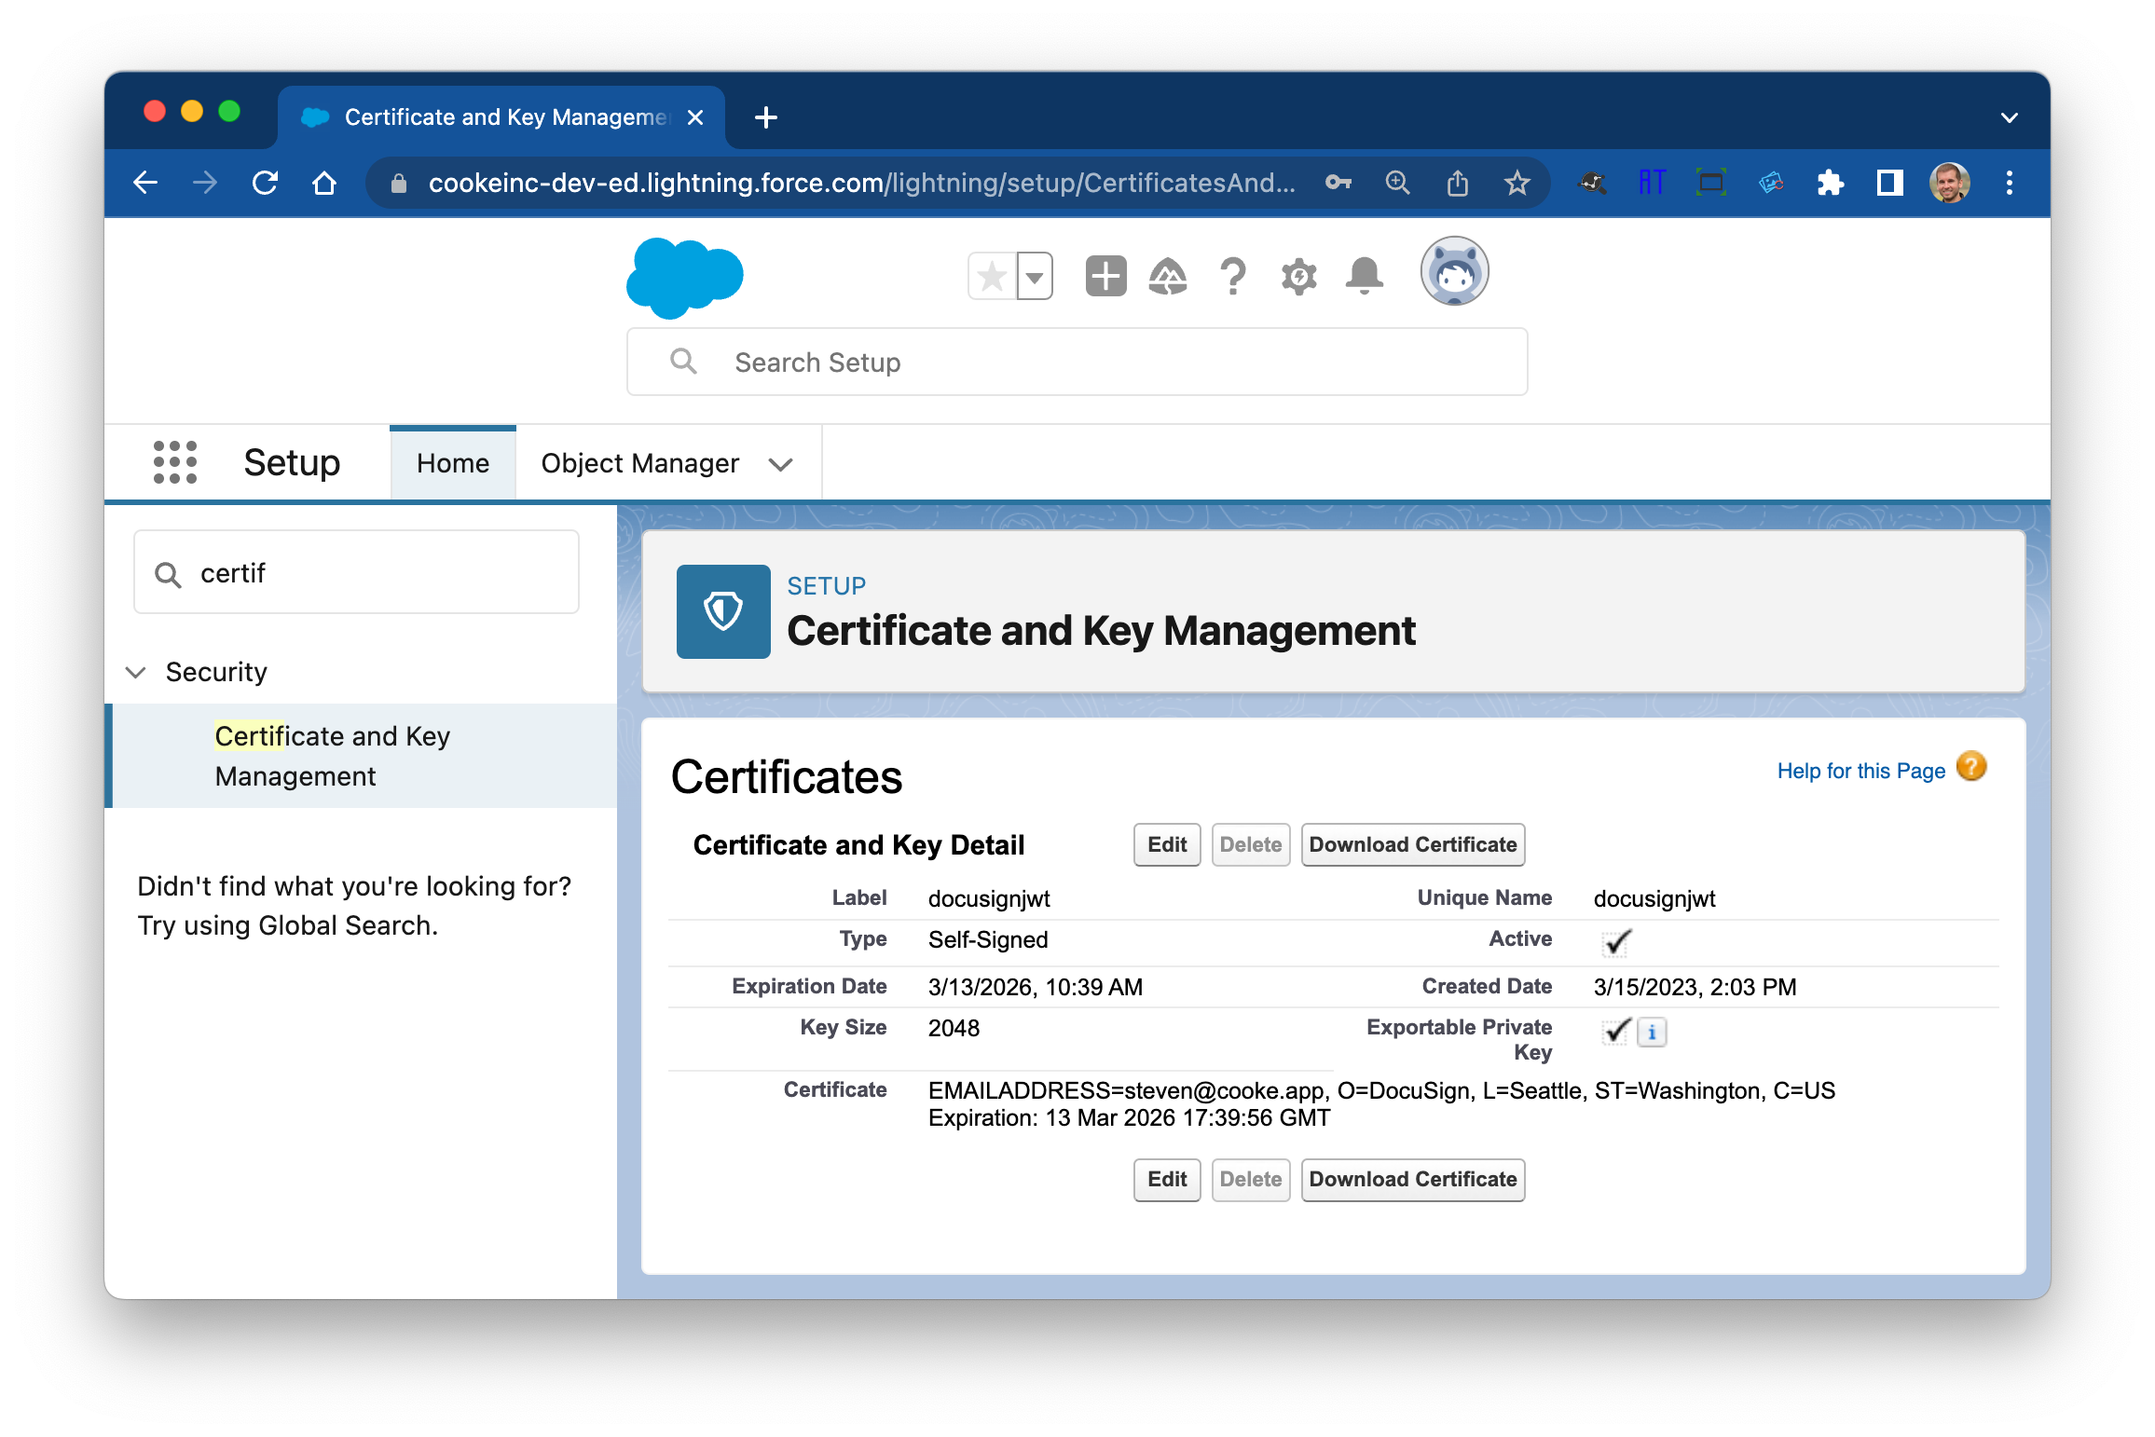
Create & Upload Signing Certificate to Salesforce

Slide 7
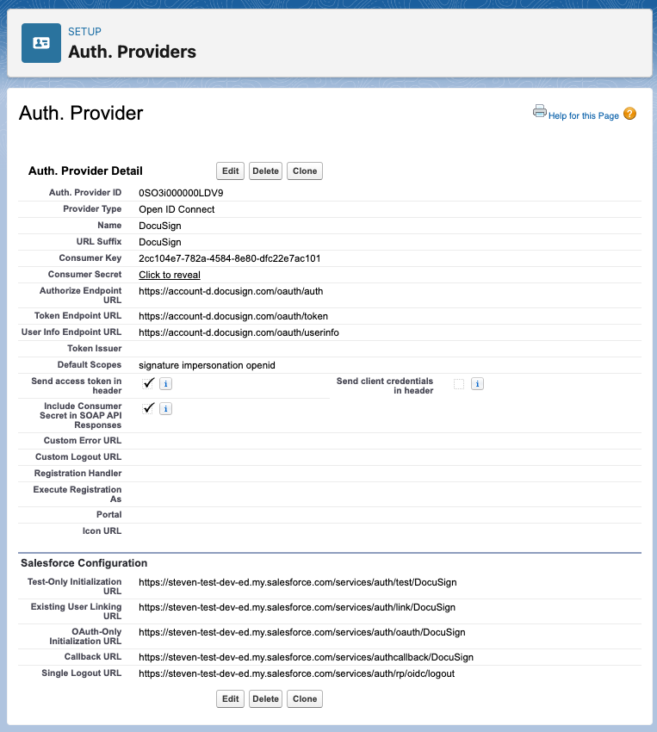
Create an Authentication Provider for DocuSign
In your Salesforce org, from Setup, enter Auth. Providers in the Quick Find box, then select Auth. Providers.
Click New, and select Open ID Connect.
Name the Auth Provider DocuSign, and enter DocuSign in the URL Suffix field.
In the Consumer Key field, enter your DocuSign App's Integration Key.
For Consumer Secret, enter your DocuSign App's Secret Key.
For Authorize Endpoint URL, enter https://account-d.docusign.com/oauth/auth.
For Token Endpoint URL, enter https://account-d.docusign.com/oauth/token.
For Default Scopes, enter signature impersonation openid.
Select Send access token in header.
Select Include Consumer Secret in API Responses.
Click Save. This saves your auth provider and generates Salesforce Configuration URLs.
Copy the Callback URL.
From your DocuSign account, in the App Details panel, click Edit.
For Redirect URIs, paste the Callback URL and click save
Copy the callback URL and paste into your browser and walk through the Oauth consent flow
Do not move past this point if the consent flow doesn’t happen, trying adding all the Salesforce URLs into the DocuSign Redirect URIs for your app and try again
Click Save.

Slide 8
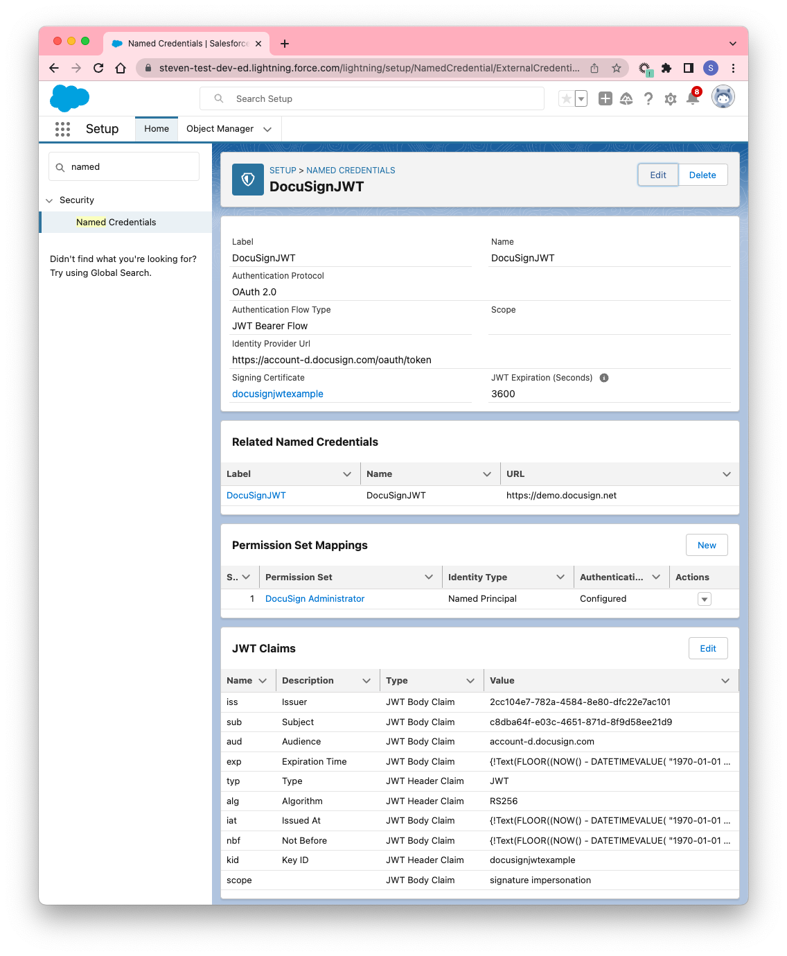
Create External Credentials
Fill in the information with the parameters outlined in DocuSign HERE
After you create the External Credential you will need to:
Add DocuSign Administrator Permission Set Mappings or a permission set that your consented user has in Salesforce
Update the JWT claims with your DocuSign Integrator Key values and add in scope of signature impersonation

Slide 9
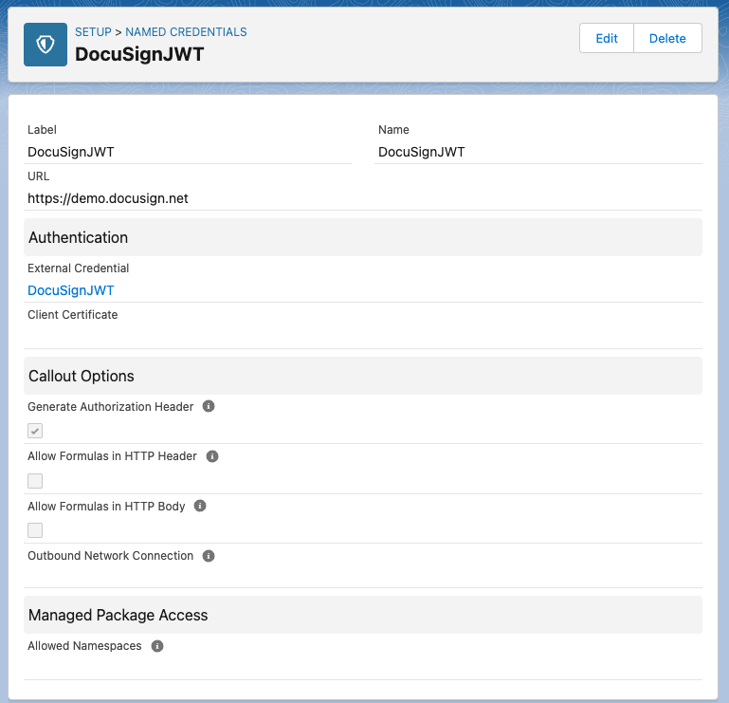
Create Named Credentials
Input DocuSignJWT for the label and name
URL is https://demo.docusign.net
Select the External Credentials you created in the step before and click save
Now you can make API calls referencing the name for your Named Credentials:

Slide 10
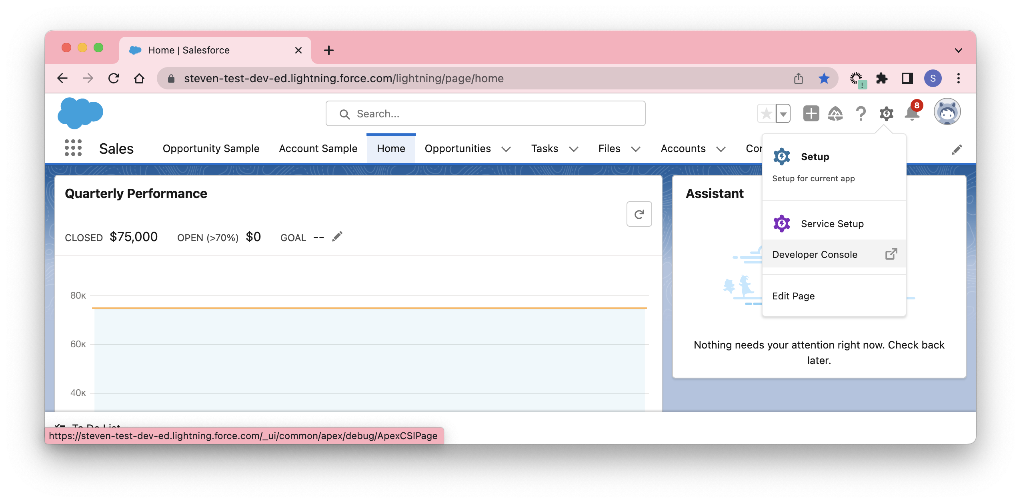
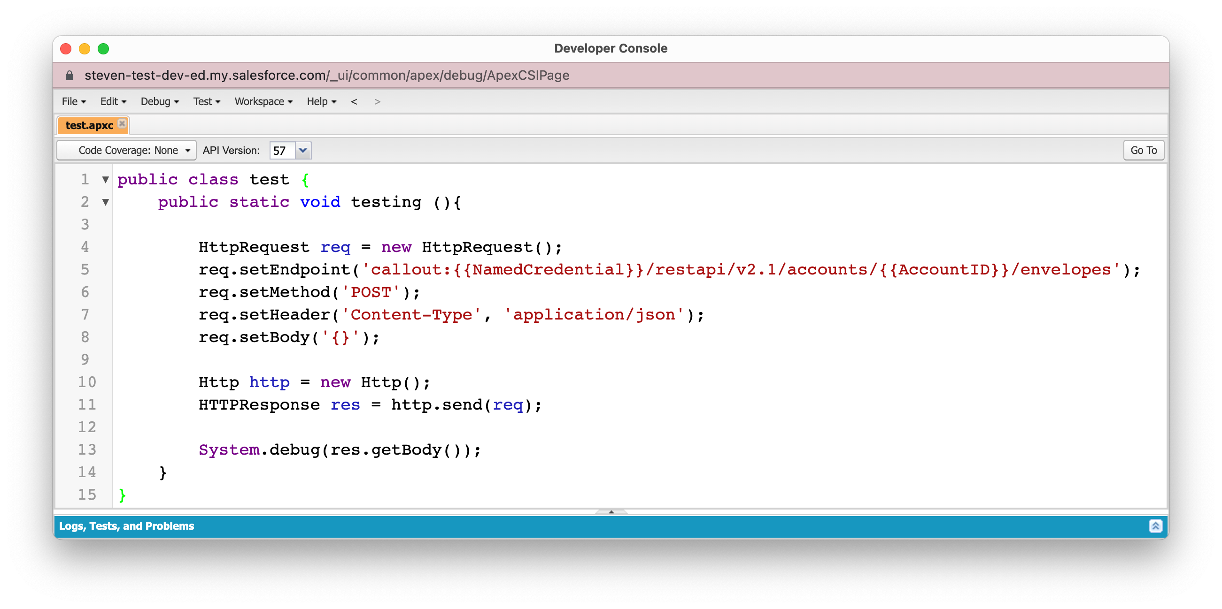
Test API Call
Navigate to the Salesforce Developer Console
Create a new apex class called test and add in the code shown making sure to replace the NamedCredential and AccountId with your information then click save
public class test {
public static void testing (){
HttpRequest req = new HttpRequest();
req.setEndpoint('callout:DocuSignJWT/restapi/v2.1/accounts/10865531/envelopes');
req.setMethod('POST');
req.setHeader('Content-Type', 'application/json');
req.setBody('{}');
Http http = new Http();
HTTPResponse res = http.send(req);
System.debug(res.getBody());
}
}

Slide 11
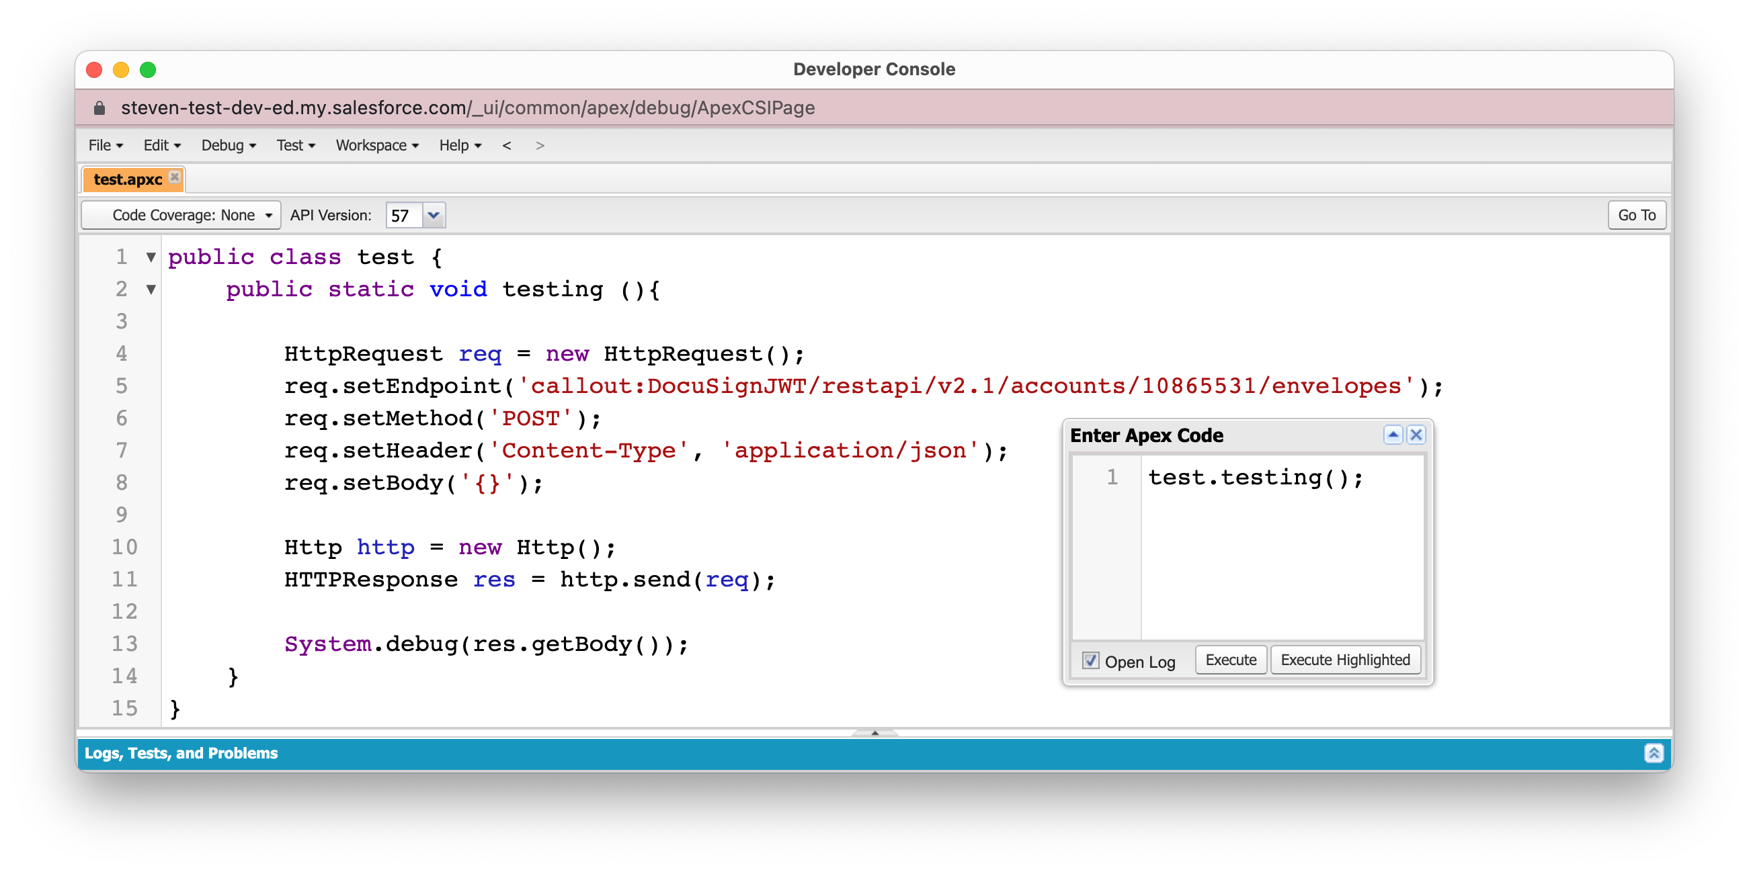
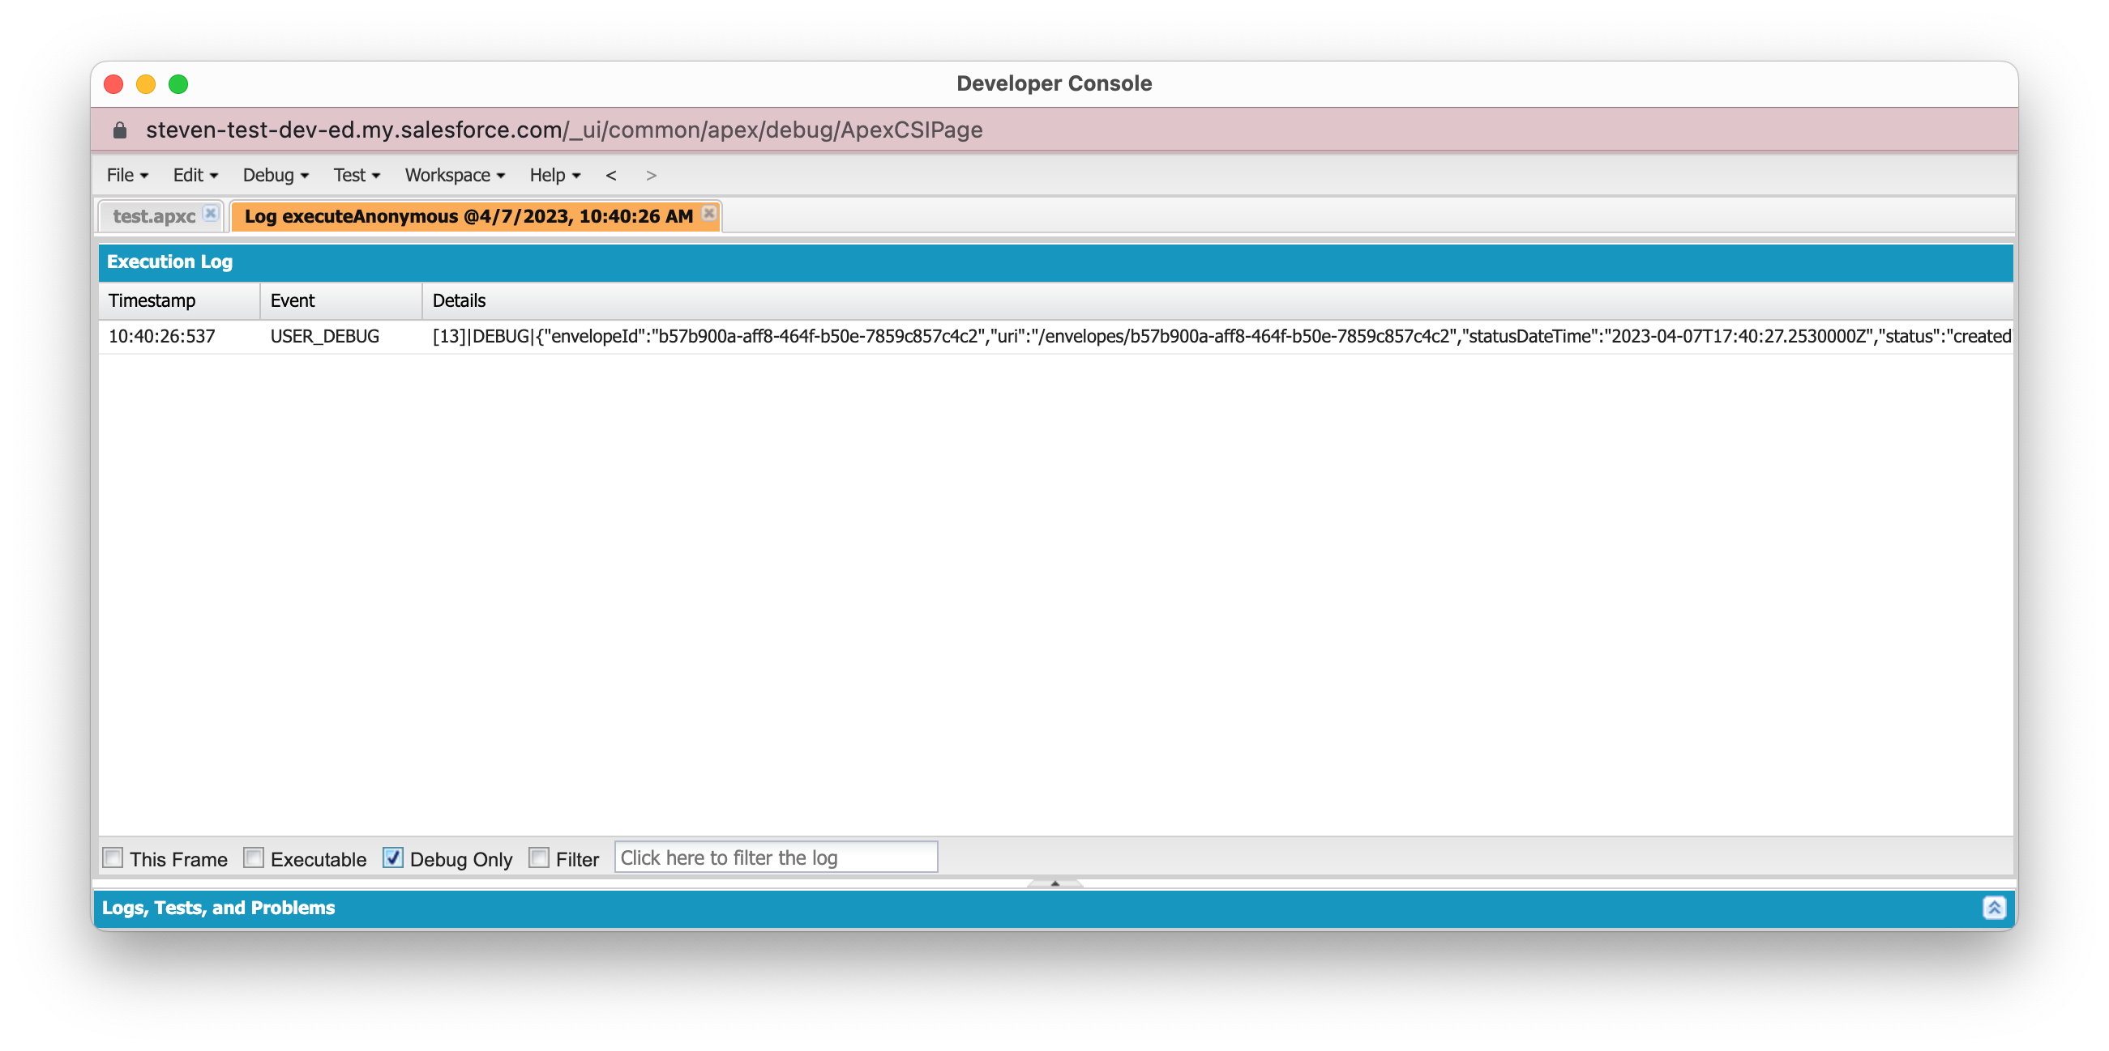
Test API Call
Click Debug > Open Execute Anonymous Window and type in the name of your public class and method to execute test.testing();
Once a new window opens up click on Debug Only in the bottom left corner to verify that a draft envelope was created

Slide 13
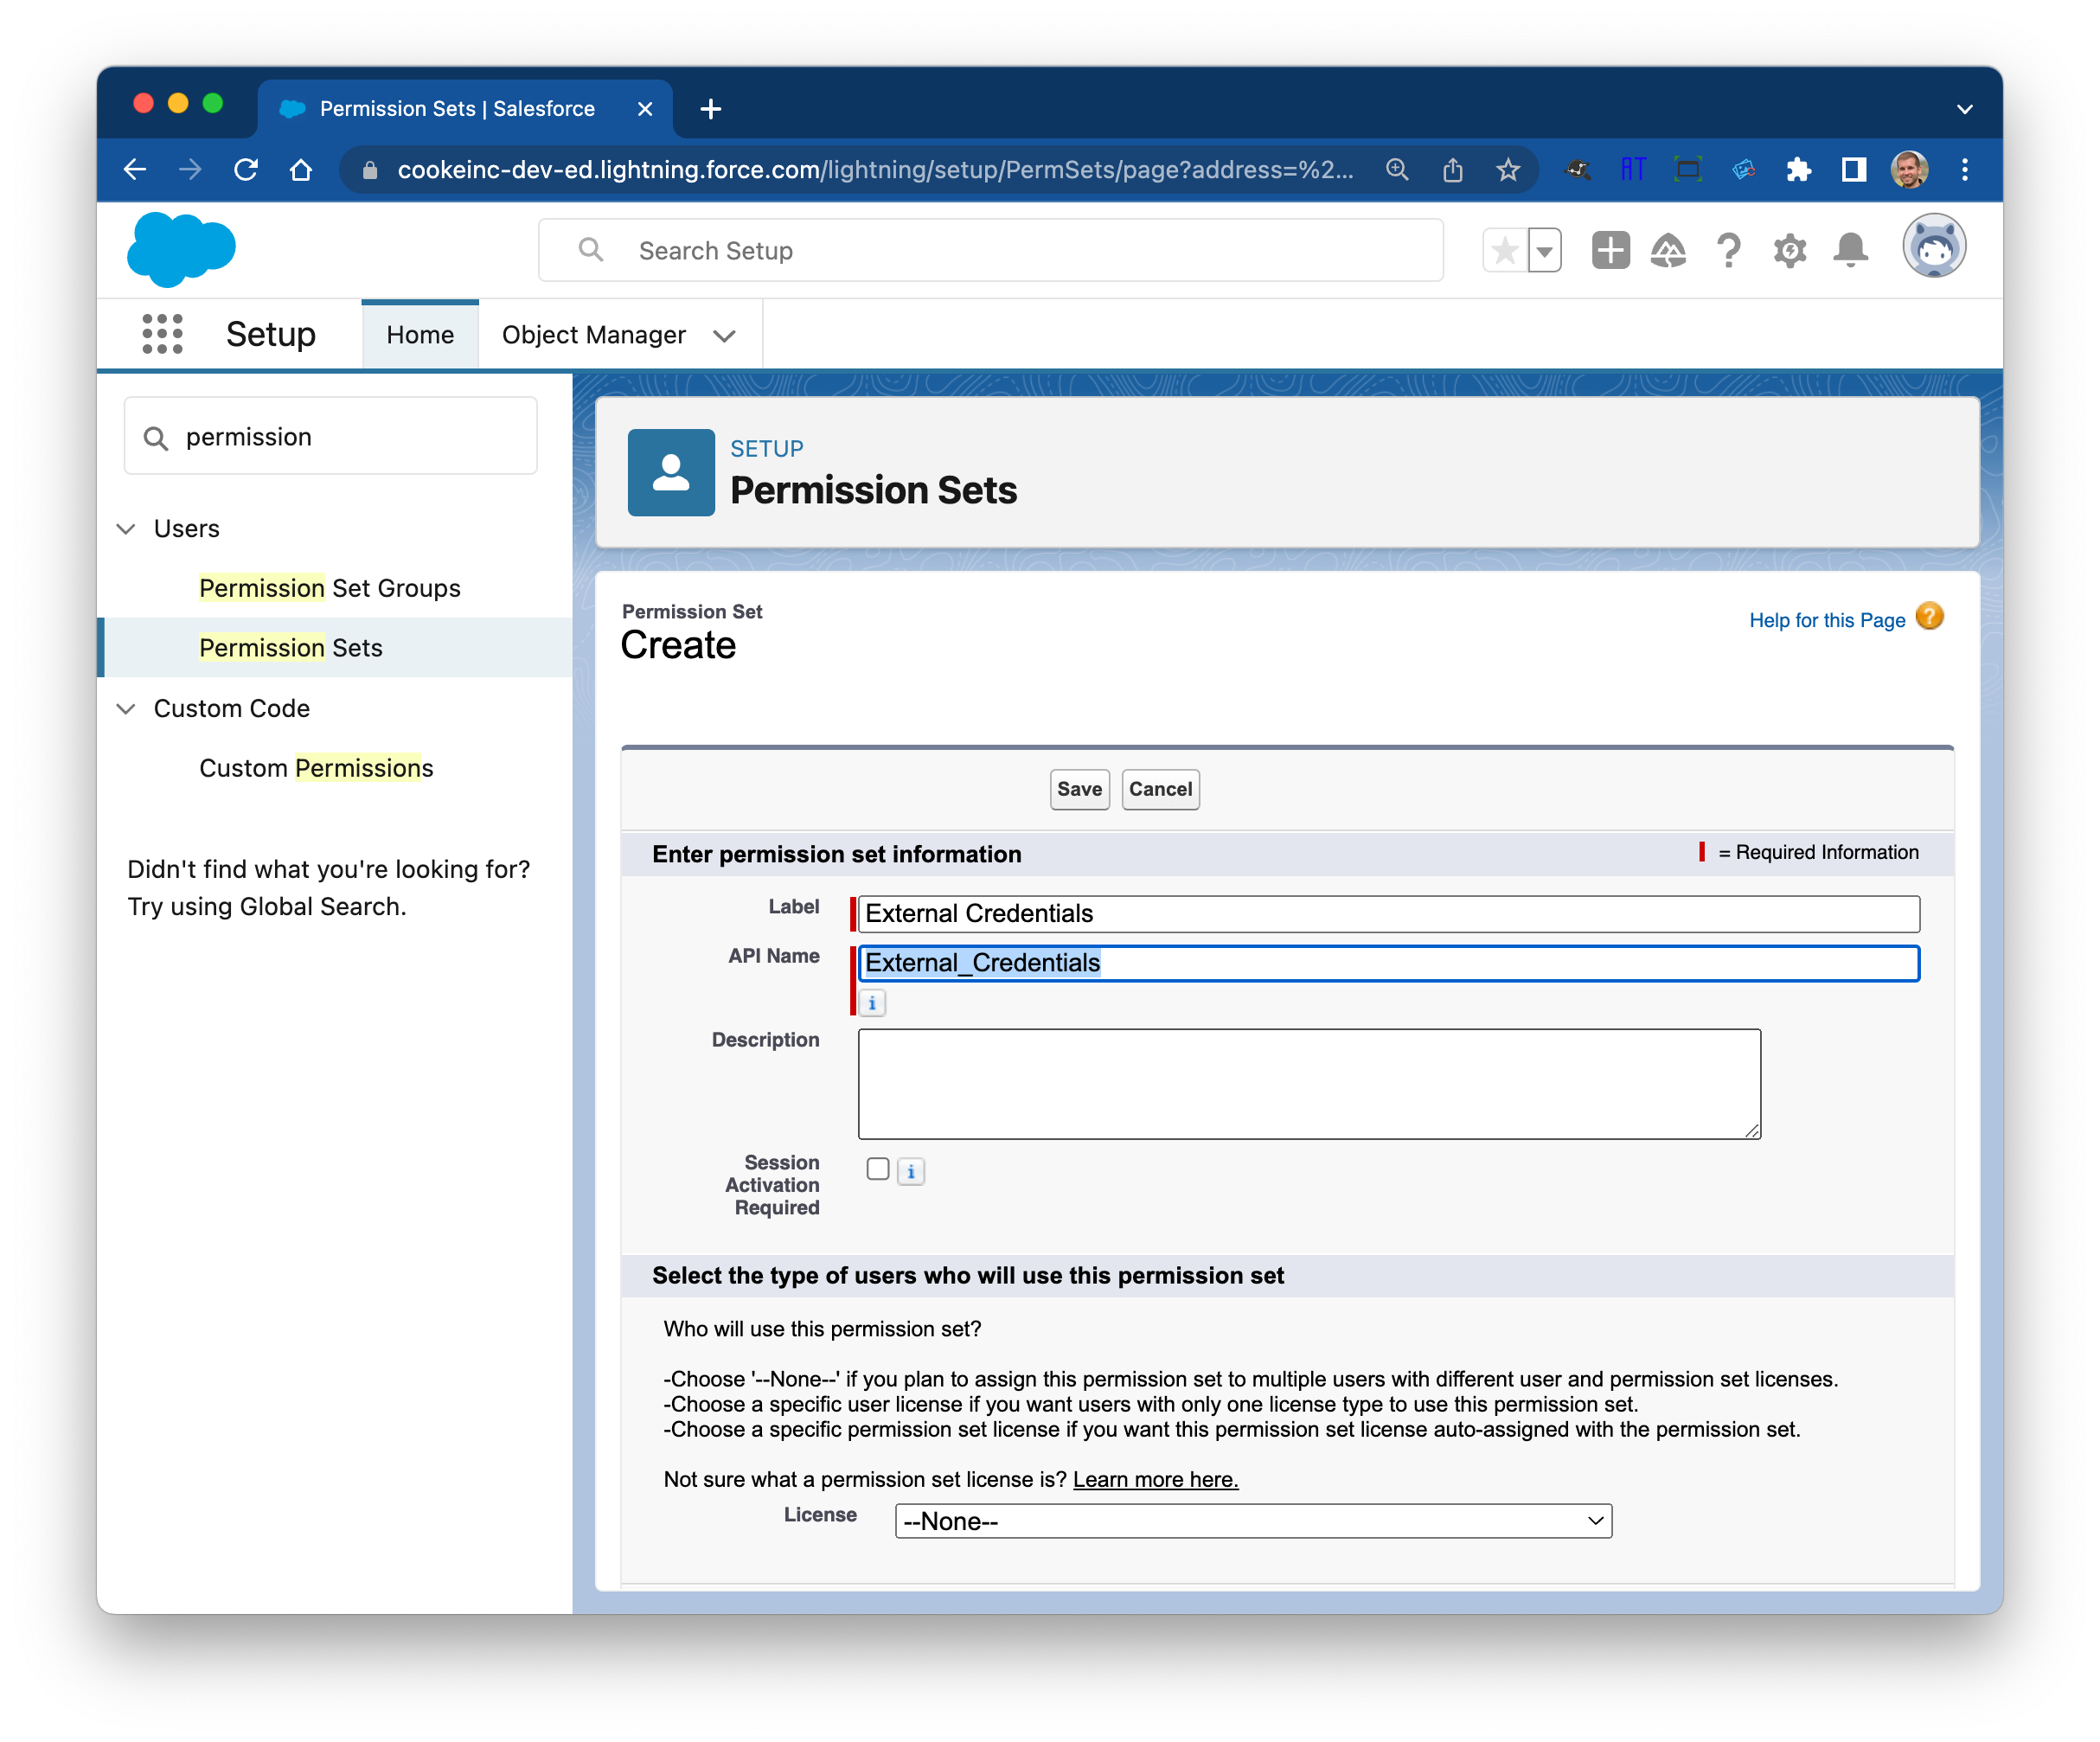
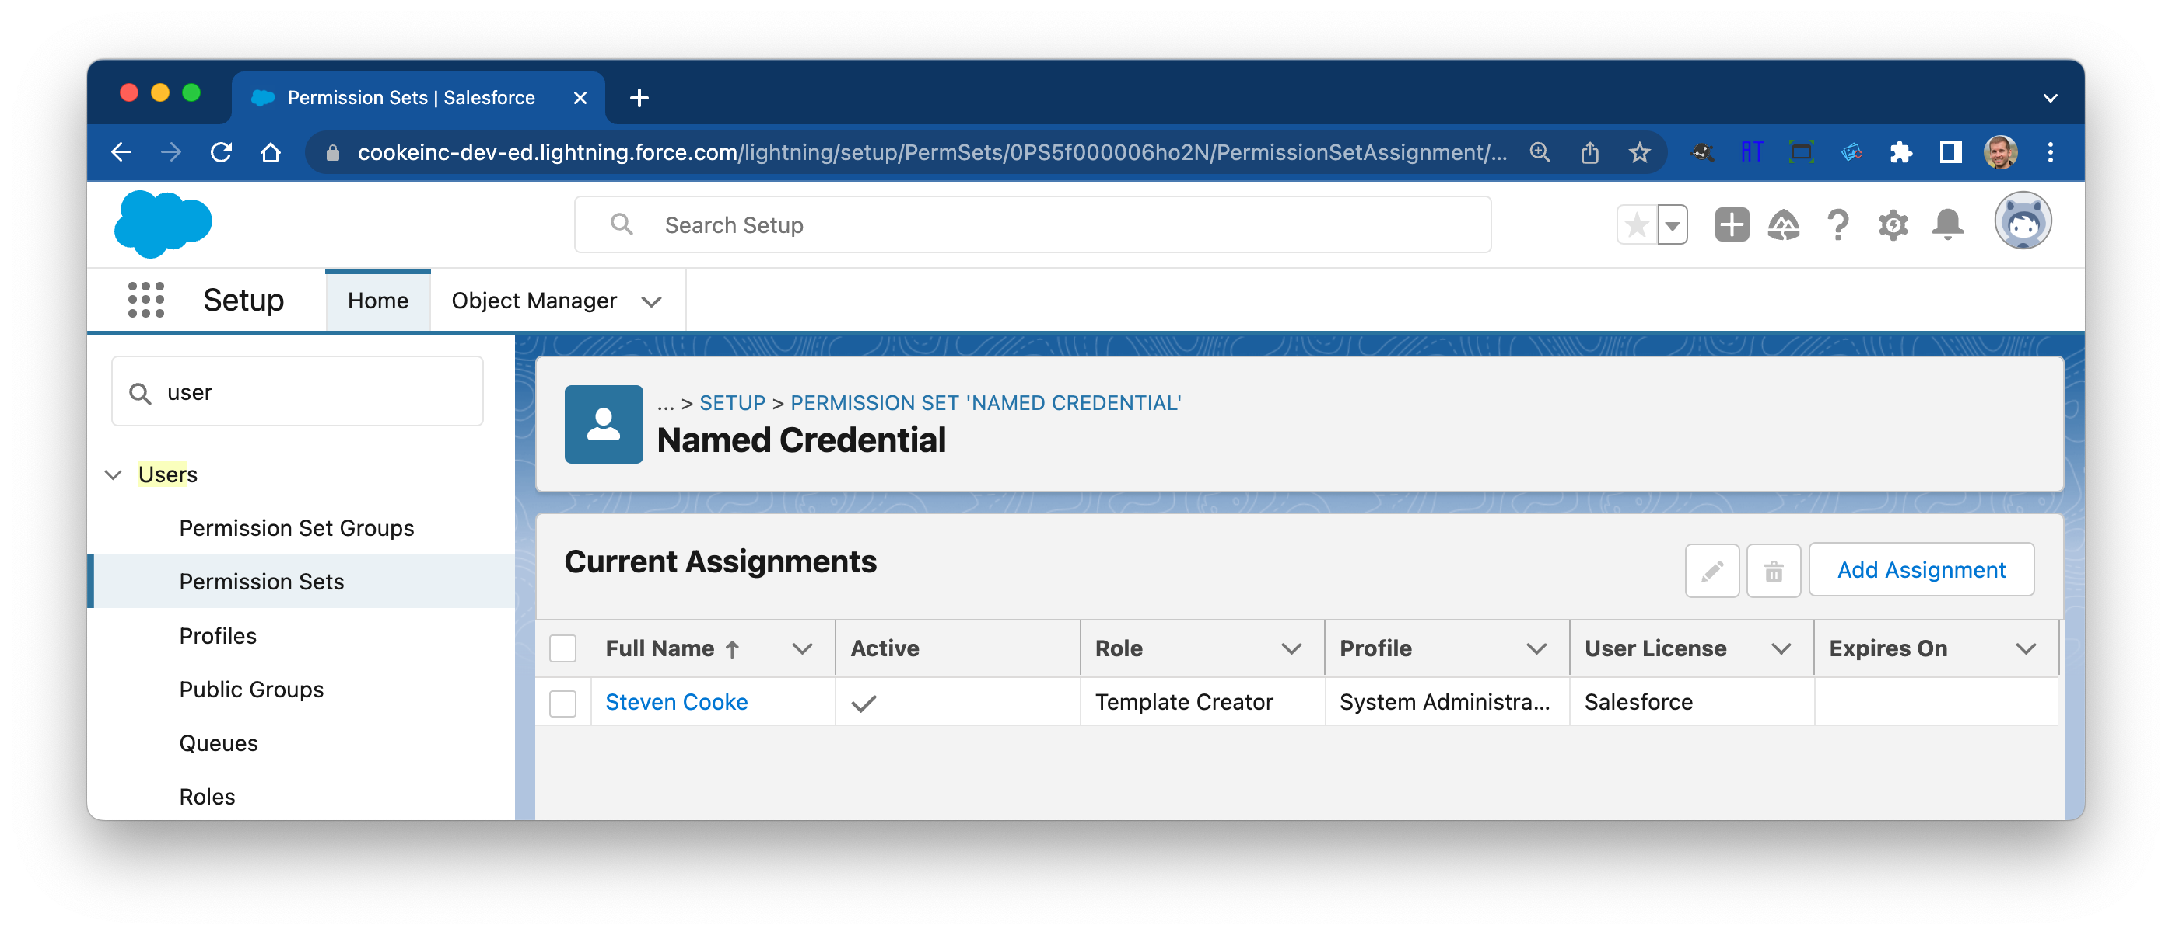
Create and Assign Named Credentials Permission Set
Create a custom permission set of Named Credentials and assign it to the users that will be making the API call

